Slide 1

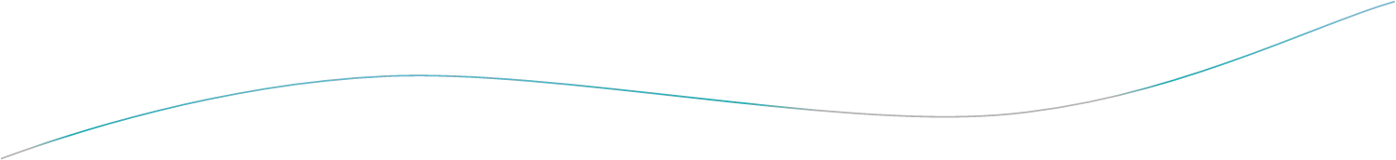
A LECTURE ON
TRANSPORTATION MODEL

Slide 2
Outline
•
Introduction
•
Solution Procedure for Transportation Problem
•
Finding an Initial Feasible Solution
•
Finding the Optimal Solution
•
Special Cases in Transportation Problems
•
Maximisation in Transportation Problems
•
Exercises

Slide 3

Operation Research
The main typical issues in OR :
Formulate the problem
Build a mathematical model
Decision Variable
Objective Function
Constraints
Optimize the model

Slide 4
Introduction
Transportation problem is one of the linear Programming Problem
The objective is to minimize the cost of distribution a product from a no of sources or origin to a no of destination in such a manner to minimize the total transportation cost.

Slide 5
For example
Manufacturer has three plants P₁, P₂, P₃ producing same products.
From these plants, the product is transported to three
warehouses W₁, W₂ and W₃.

Slide 6
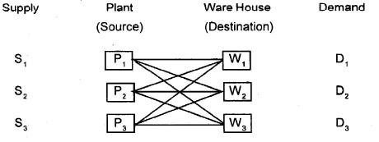
Each plant has a limited capacity, and each warehouse has specificdemand. Each planttransport to each warehouse, but transportation cost vary for different combinations.

Slide 7
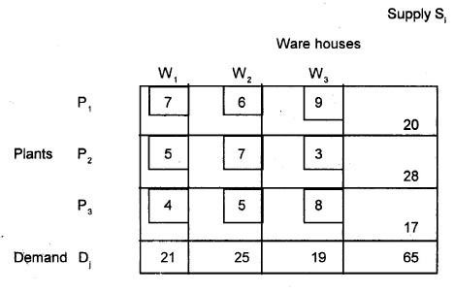
Steps to solve a transportation problem
¬ Formulate the problem and setup in the matrix form.
¬ Obtain the initial basic feasible solution.
¬
¬
Test the solution for optimality.
Updating the solution if required.
For example:

Slide 8
Finding an Initial Feasible Solution
There are a number of methods for generating an initial feasible solution for a transportation problem.
Consider three of the following
North West Corner Method
Least Cost Method
Vogel’s Approximation Method

Slide 9
North West Corner Method (NWCM)
The simplest of the procedures used to generate an initial feasible solution is NWCM. It is so called because we begin with the North West or upper left corner cell of our transportation table. Various steps are given
Step 1
Select the North West (upper left-hand) corner cell of the transportation table and allocate as many units as possible equal to the minimum between available supply and demand requirement i.e., min (S₁, D₁).
Step 2
Adjust the supply and demand numbers in the respective rows And columns allocation.

Slide 10
Step 3
If the supply for the first row is exhausted, then move down to the first cell in t he second row and first column and go to step 2.
If the demand for the first column is satisfied, then move horizontally to the next cell in the second column and first row and go to step 2.
Step 4
If for any cell, supply equals demand, then the next allocation can be made in cell either in the next row or column.

Slide 11
Step 5
Continue the procedure until the total available quantity id fully allocated to the cells as required.
Remark 1: The quantities so allocated are circled to indicated,
the value of the corresponding variable.
Remark 2: Empty cells indicate the value of the corresponding variable as zero, I.e., no unit is shipped to this cell.

Slide 12
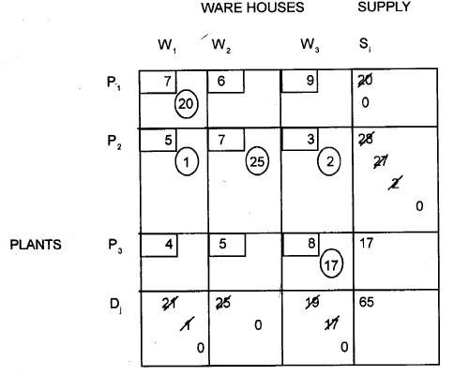
To illustrate the NWCM,
As stated in this method, we start with the cell (P₁ W₁) and Allocate the min (S₁, D₁) = min (20,21)=20. Therefore we allocate 20 Units this cell which completely exhausts the supply of Plant P₁ and leaves a balance of (21-20) =1 unit of demand at warehouse W₁

Slide 13
Least Cost Method
The allocation according to this method is very useful as it takes into consideration the lowest cost and therefore, reduce the computation as well as the amount of time necessary to arrive at the optimal solution.
Step 1
Select the cell with the lowest transportation cost among all the rows or columns of the transportation table.
If the minimum cost is not unique, then select arbitrarily any cell with this minimum cost.
Step 2
Allocate as many units as possible to the cell determined in Step 1 and eliminate that row (column) in which either supply is exhausted or demand is satisfied.

Slide 14
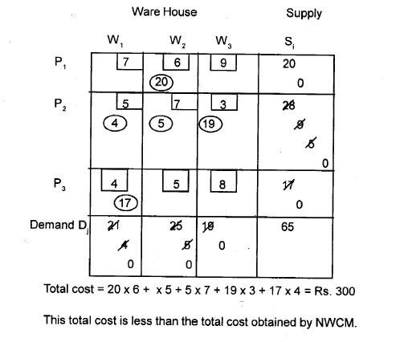
Repeat Steps 1 and 2 for the reduced table until the entire supply at different plants is exhausted to satisfied the demand at different warehouses.

Slide 15
Vogel’s Approximation Method
(TVhAis mMeth)od is preferred over the other two methods because the initial feasible solution obtained is either optimal or very close to the optimal solution.
Step 1:
Compute a penalty for each row and column in the transportation table.
Step 2:
Identify the row or column with the largest penalty.
Step 3:
Repeat steps 1 and 2 for the reduced table until entire supply at plants are exhausted to satisfy the demand as different warehouses.

Slide 16
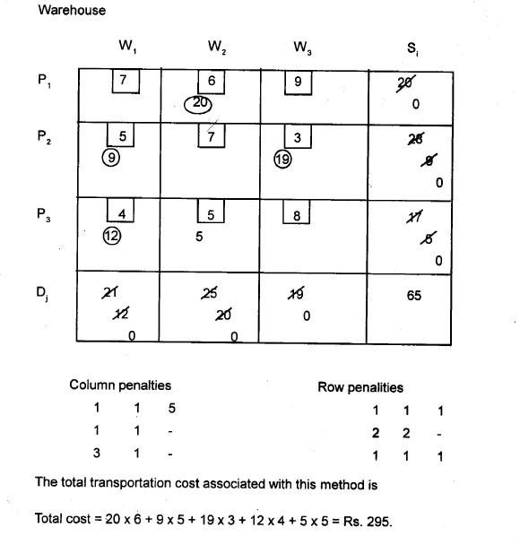

Slide 17
Steps in Transportation Model :
Formulation of Model (IF UBTP -> BTP)
Obtain IBFS (NWCRM or LCM or VAM )
Test of Optimality
Optimization by MODI method
a) Calculate Ri and Kj such that Cij = Ri + Kj for Stone cells
b) Determine Improvement Potential Cell values of Water Cells: IP values = Cij –(Ri + Kj) >= 0

Slide 18
Finding the Optimal Solution
Once an initial solution has been found, the next step is to test that solution for optimality. The following two methods are widely used for testing the solutions:
θ Stepping Stone Method
θ Modified Distribution Method
Necessary condition
Make sure that the number of occupied cells is exactly equal to m+n- 1, where m=number of rows and n=number of columns.
Each occupied cell will be at independent position.

Slide 19

Stepping-Stone Method
In this method we calculate the net cost change that can be obtained by introducing any of the unoccupied cells into the solution.
Steps
Check the optimality test necessary condition
Evaluate each unoccupied cells by following its closed path and determine its net cost change.
Determine the quality to be shipped to the selected unoccupied cell. Trace the closed path for the unoccupied cell and identify the minimum quality by considering the minus sign in the closed path.

Slide 20

Modified Distribution (MODI) Method
The MODI method is a more efficient procedure of evaluating the unoccupied cells. The modified transportation table of the initial solution is shown below
Steps
1.Determine the initial basic feasible solution by using any method. 2.Determine the value of dual variable u_{i} , v_{j} by using c_{ij} = u_{i} + v_{j}
for occupied cell . Associate a number, u_{i}, with each row and v_{j}
with each column.
3.Compute opportunity cost for unoccupied cell by d_{ij} = c_{ij} - u_{i} - v_{j}.

Slide 21
Contd..
Check the sign for each opportunity cost. If the opportunity cost for each unoccupied cell is positive or zero then the solution is optimum. Otherwise
Select the unoccupied cell with largest negative opportunity cost draw a close loop.
Assign alternative positive and negative sign at corner points of the closed loop(start from unoccupied cell with positive sign)
Determine the maximum number of units that should be allocated to this unoccupied cell. This should be added to cells with positive sign and subtracted from negative sign
Repeat procedure till an optimal solution is obtained

Slide 22
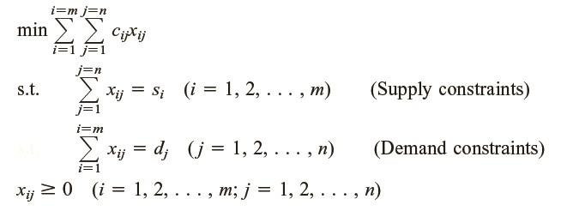
Model to be optimized
Objective function
cij = variable cost
xij = number of unit transported from supply point i to demand j

Slide 23
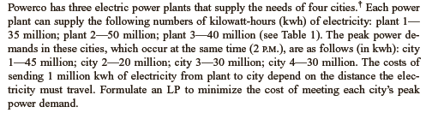
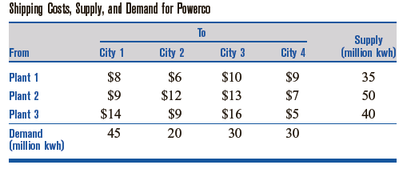
Example
Problem

Slide 24
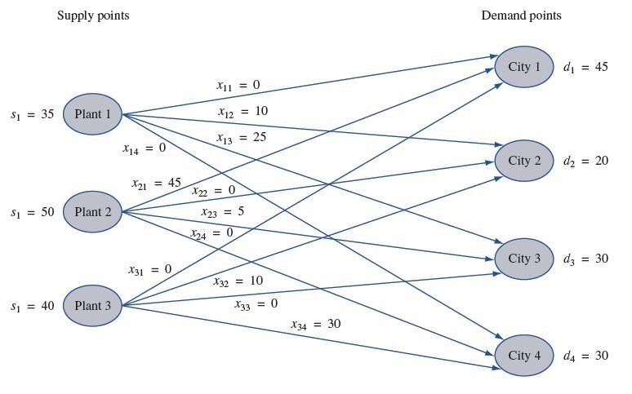
i = number of sources
j = number of demands

Slide 25
Decision variable
Number of millions energy (kWh) produced from sources and sent to demands
x (i,j) = number of sources
i = number of sources j = number of demands

Slide 26
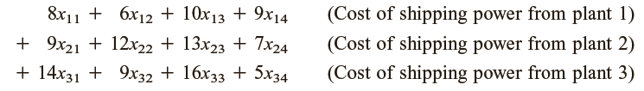
Objective function
¬
Minimize cost
cost =

Slide 27

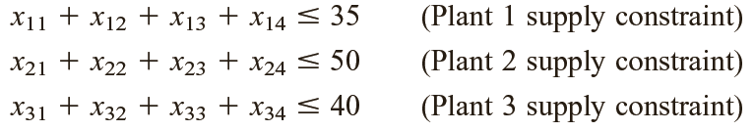
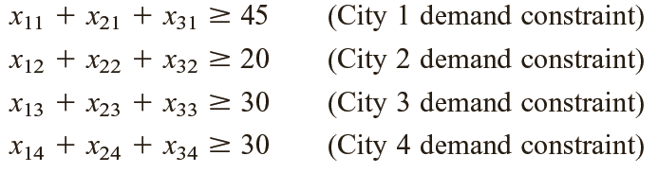
Constraints
¬
Constraints of number of Supply and demand x (i,j) > 0 (i = 1,2,3) and j=1,2,3,4)
Constraints of Supply
¬
¬
Constraints of Demands
j = number of demands

Slide 28
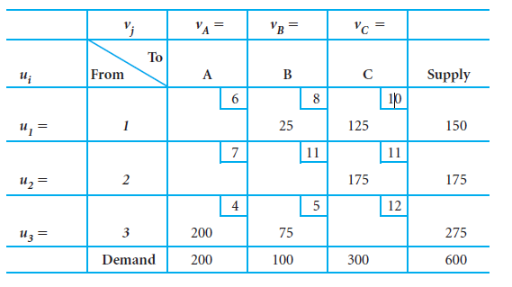
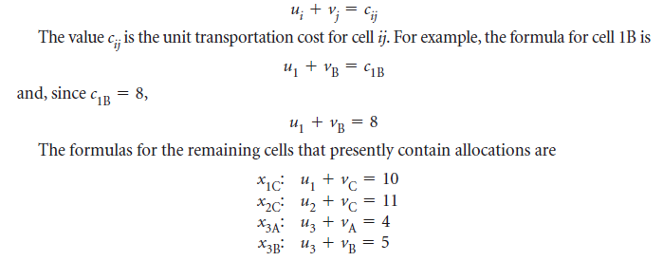
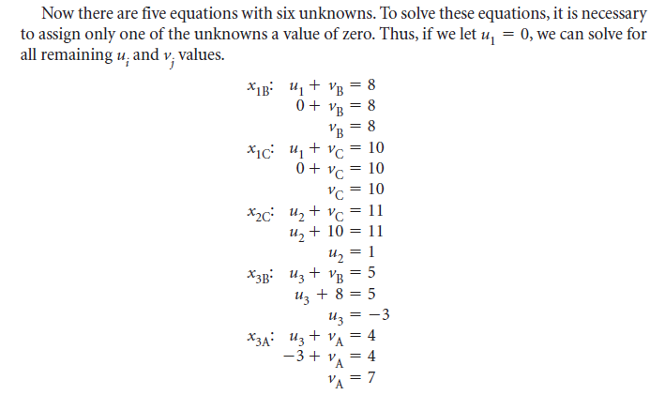
MODI Method (u-v method)

Slide 29
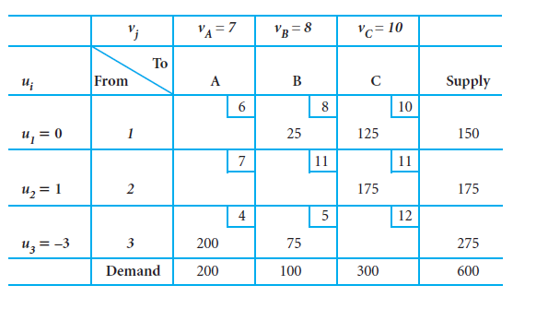
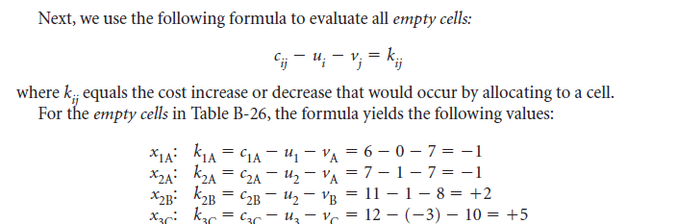
IP values:

Slide 30
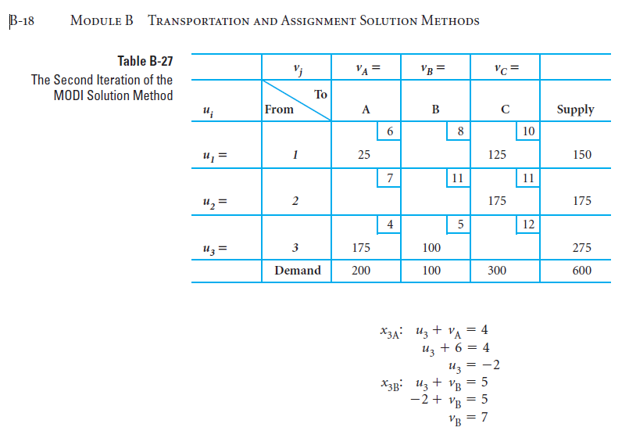
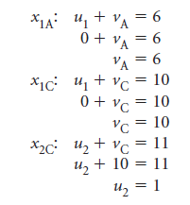

Slide 31
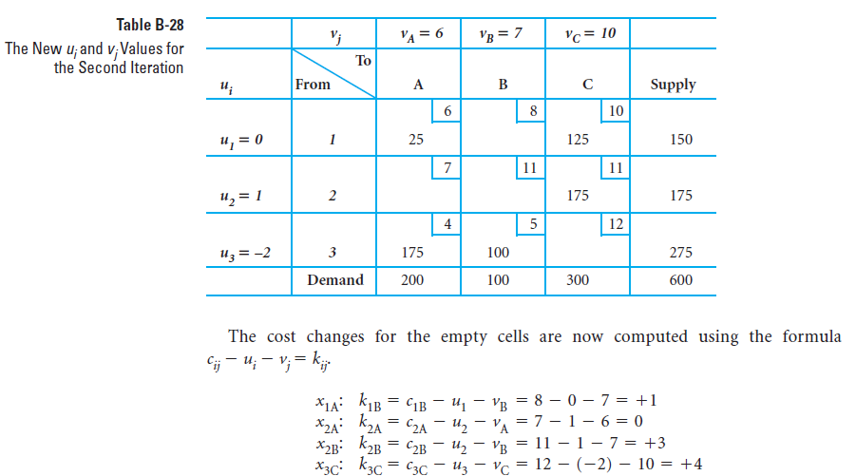

Slide 32
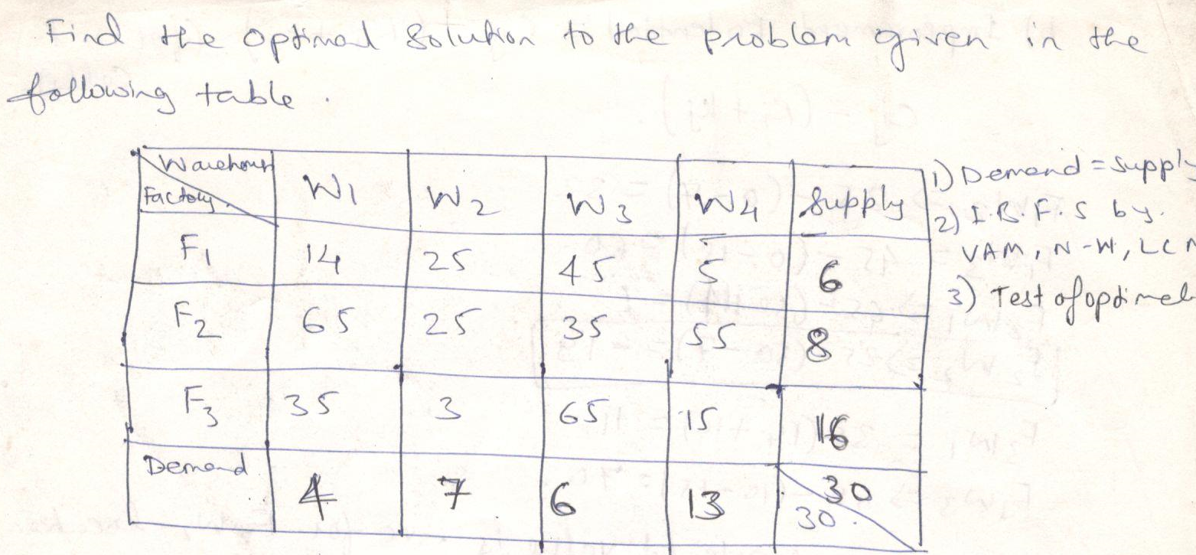

Slide 33
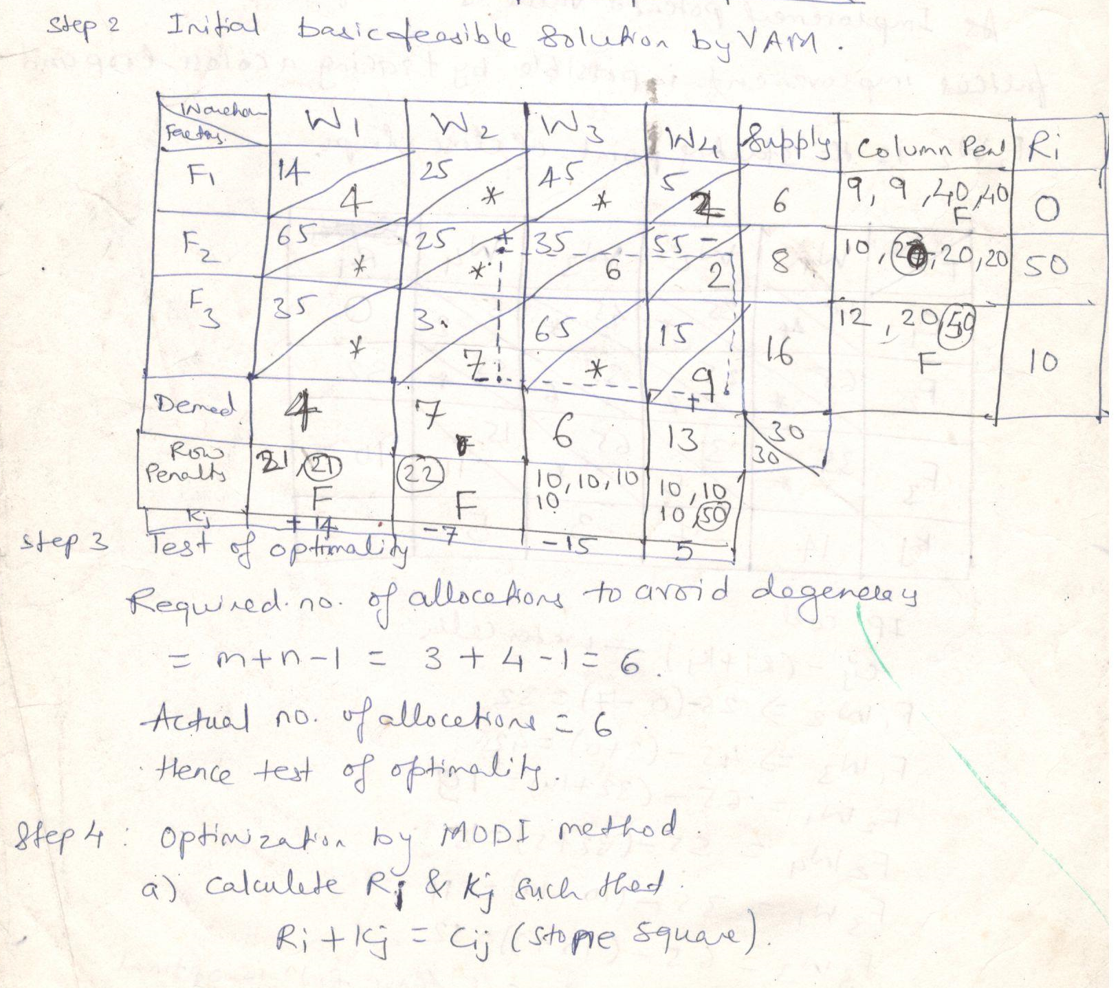

Slide 34
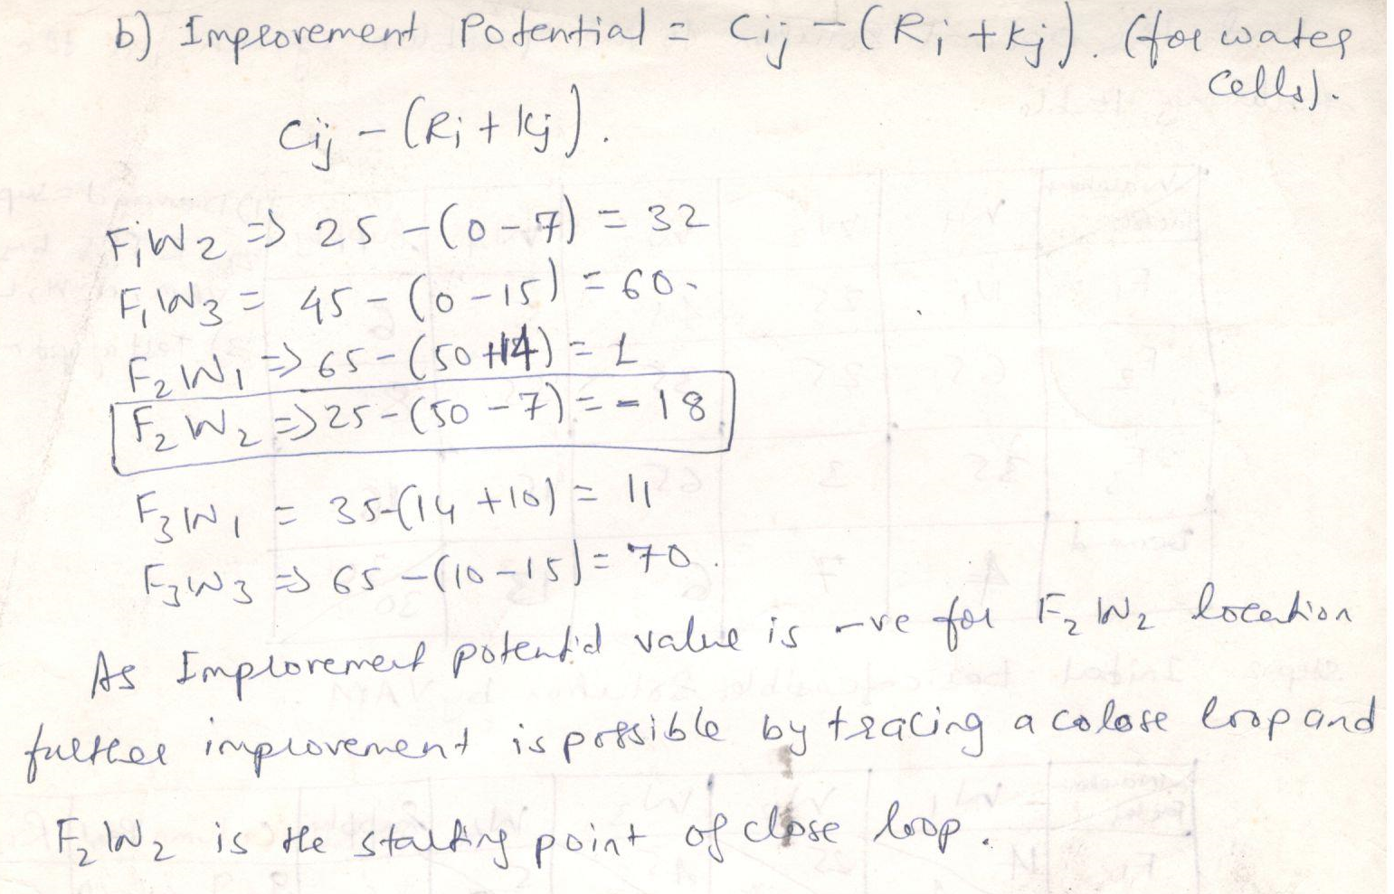

Slide 35
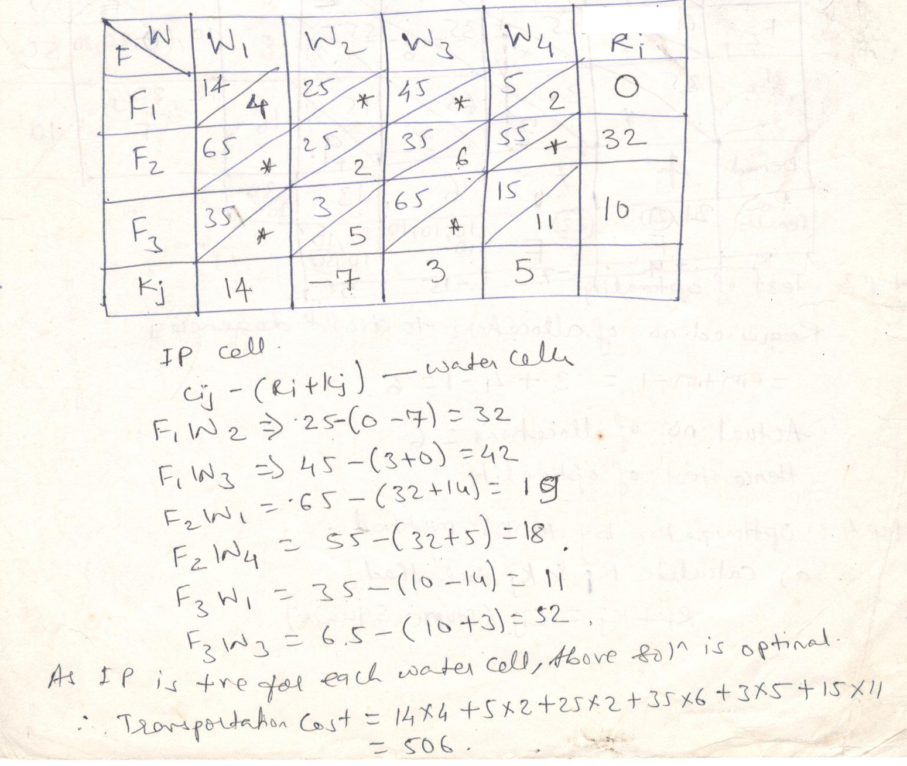

Slide 36
Special Cases in Transportation Problem
♣Multiple Optimal Solutions
♣Unbalanced Transportation Problems
♣Degeneracy in Transportation Problem
♣Maximization In Transport Problems

Slide 37
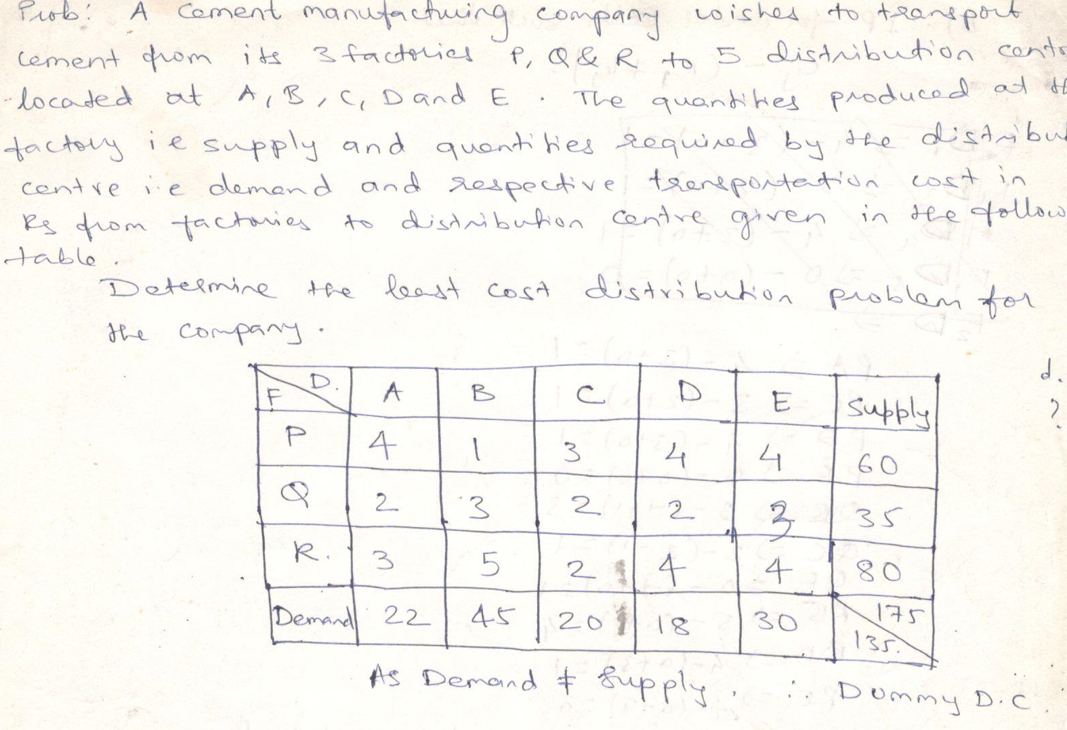
Unbalanced Transportation Problems

Slide 38
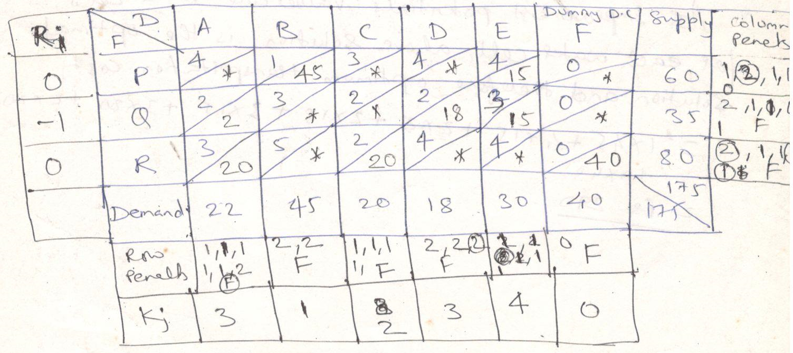
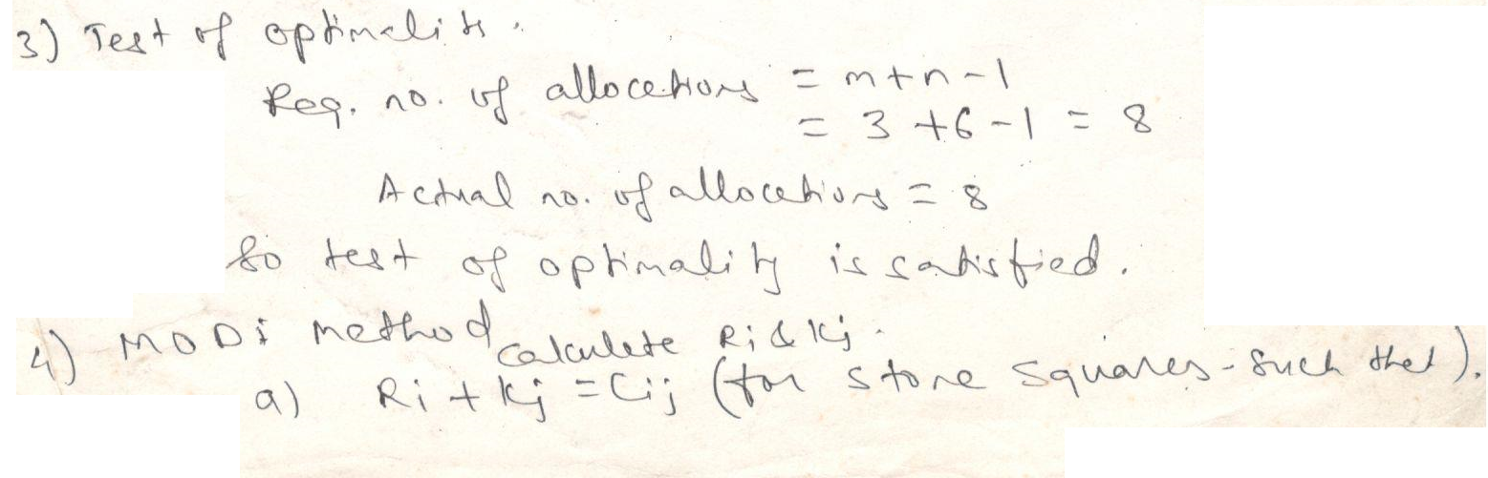

Slide 39
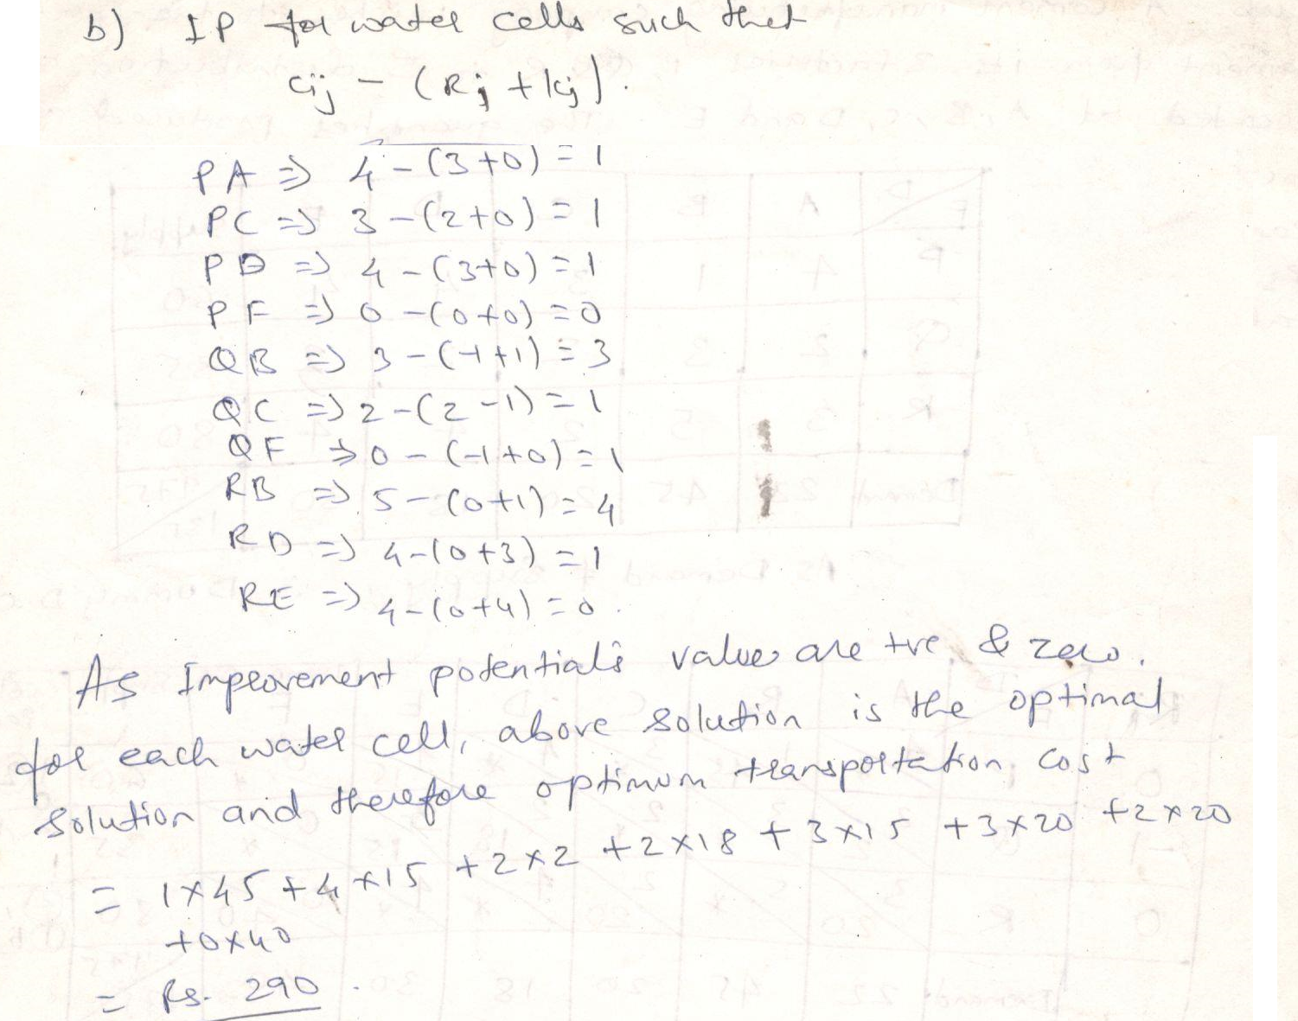

Slide 40
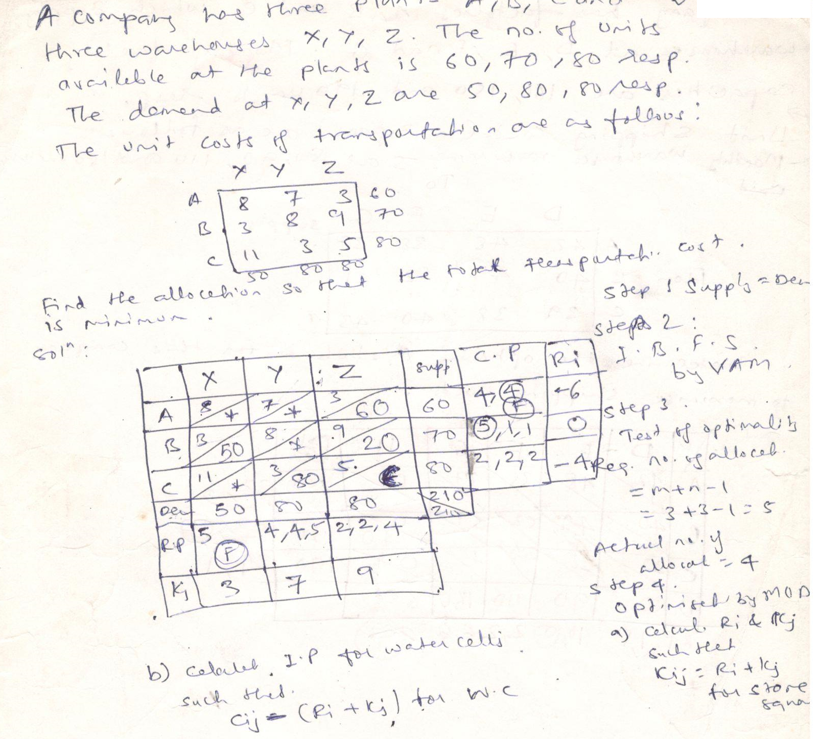

Slide 41
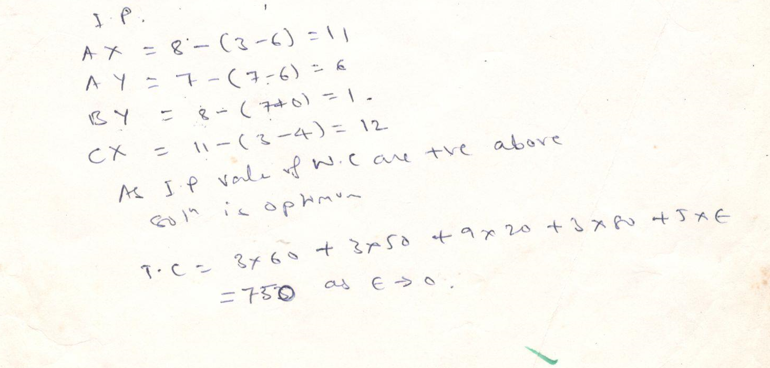

Slide 42
Maximization Transportation Problems

Slide 43
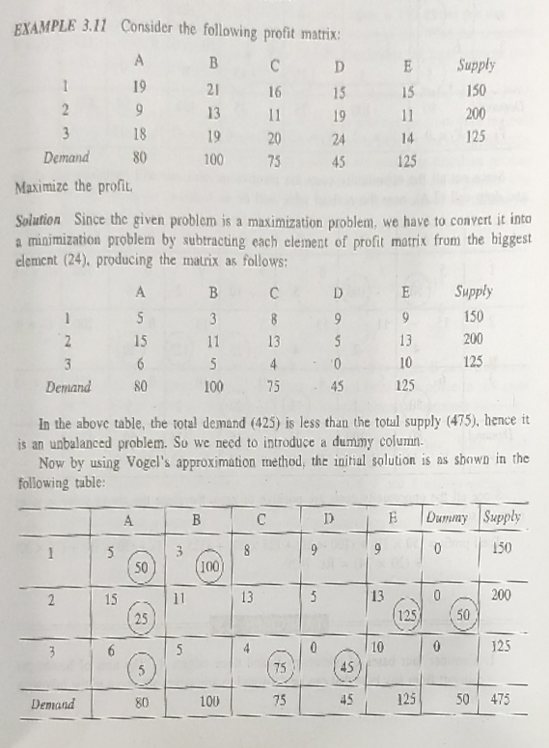

Slide 44
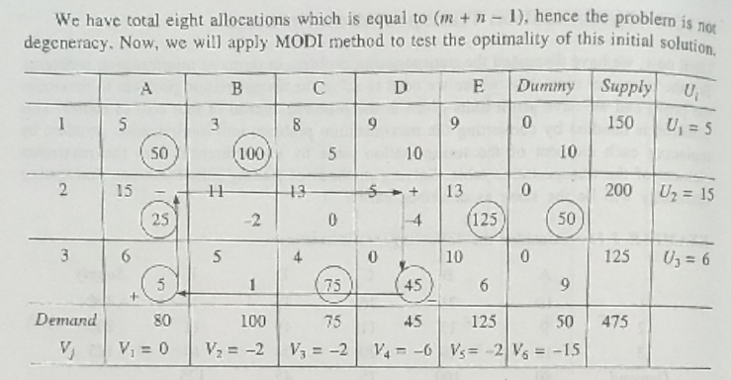

Slide 45
